Slide 1
CSC2203 – Visual Basic Workshop
Lecture 2: Planning Applications and Designing Interfaces
A. A. Datti
1

Slide 2

Course Outline
An Introduction to Visual Studio and Visual Basic
Planning Applications and Designing Interfaces
Coding with Variables, Named Constants and Calculations
The Selection Structure
The Repetition Structure
Subroutine and Function Procedures
Arrays
Sequential Access Files and Menus
SQL Server Databases

Slide 3
Objectives
Planning a Windows Forms Application
Windows Standards for Interfaces
Access Keys
Tab Order

Slide 4
Planning an Application
Before you begin creating a Windows Forms application, you need to plan it.
The steps listed in Figure 2-1 will help you accomplish this important task.
In this lesson, you will use the steps to plan the Restaurant Tip application, which calculates a server’s tip based on two amounts:
the user’s restaurant bill and
the tip percentage.

Slide 5
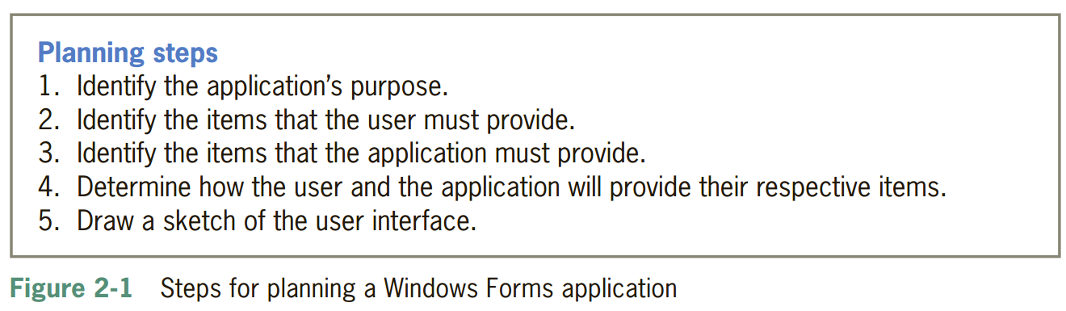
Planning an Application
Before continuing to Step 4 in the planning process, it is helpful to record the information from Steps 1 through 3 in a Planning Chart.

Slide 6
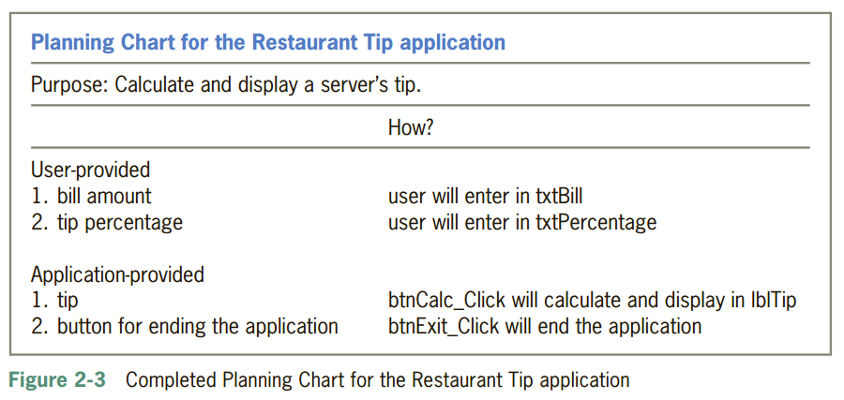
Planning Chart

Slide 7
Planning Chart
The two items listed in the User-provided section (bill amount and tip percentage) will need to be entered by the user. Visual Basic provides many different controls for getting user input, such as text boxes, list boxes, radio buttons, and check boxes; the Restaurant Tip application will use text boxes named txtBill and txtPercentage. (The three-character ID for text box names is txt.)
The application is responsible for providing the tip item. It will employ two controls to accomplish this task: a button named btnCalc and a label control named lblTip.
Label controls are used in an interface to display text that the user is not allowed to edit during run time, such as text that identifies other controls and text that represents the result of a calculation.
The btnCalc control will calculate the tip and then assign the result to the lblTip control.
The Planning Chart also indicates that the application must provide a button for the user to end the application (btnExit ).

Slide 8
Windows Standards for Interfaces
Final step in planning an application is to draw a sketch of your application’s user interface while following some guidelines in order to simplify users task.
Guideline 1: Organization
Information should flow either vertically (top to bottom) or horizontally (left to right).
Related controls should be grouped together using either white (empty) space or one of the tools located in the Containers section of the toolbox (GroupBox, Panel etc).

Slide 9
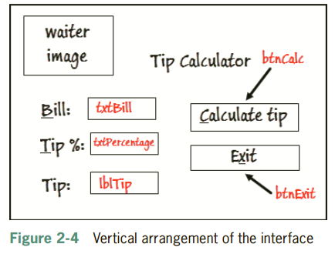
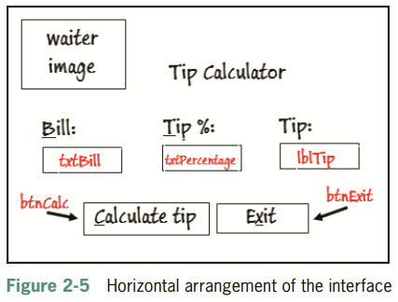
Windows Standards for Interfaces
Note the Labels by the left/top used in identifying the information needed

Slide 10
Aligning and Sizing Controls
Format menu options
Align
Allows aligning 2 or more controls by left, right, top, and bottom
Make Same Size
Allows 2 or more controls to be size to same width and/or height

Slide 11
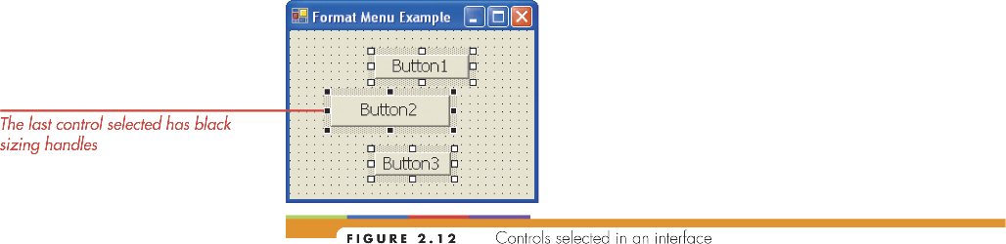
Arranging the controls (continued)
Selecting controls to align

Slide 12
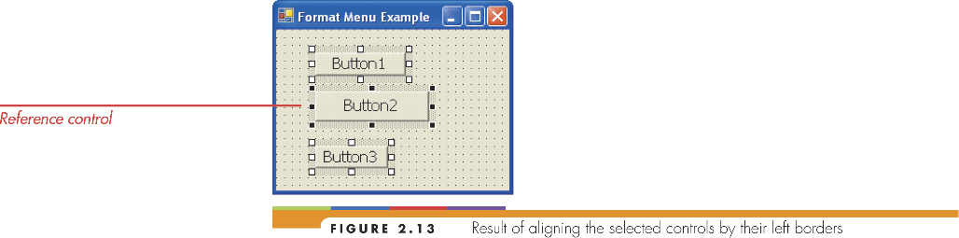
Arranging the controls (continued)
Controls aligned by left border

Slide 13
Windows Standards for Interfaces
Guideline 2a: Identifying Labels
Text contained in a label control that identifies another control’s contents should be
meaningful
left-aligned within the label.
consist of one to three words only and appear on one line.
positioned either above or to the left of the control it identifies.
end with a colon (:)
Use Sentence capitalization (capitalize only the fist letter in the first word)

Slide 14
Windows Standards for Interfaces
Guideline 2b: Identifying Buttons
The text that identifies a button is referred to as the button’s caption. It should be
meaningful,
consist of one to three words only, and appear on one line.
Use Sentence capitalization.
If stacked vertically, all the buttons should be the same height and width.
If positioned horizontally, all the buttons should be the same height, but their widths may vary if necessary.

Slide 15
Windows Standards for Interfaces
Guideline 3: Including Graphics
Use graphics sparingly
They can become distractions
Guideline 4: Selecting Fonts
Use one type (Segoe UI for instance)
Use no more than 2 different sizes
Avoid Italics and Underlines
Bold should be limited to headings and key items for emphasis

Slide 16
Windows Standards for Interfaces
Guideline 5: Using Color
Use color sparingly
Use simple black, white and grey and then add color of really necessary
If you use color then limit them to three (not including black, white and grey).
Use colors that complement each other (Blue-yellow, Red-cyan, Blue-orange, Red-green etc)

Slide 17
Access Keys
The (unique) underlined letter in a control is called an access key. It allows the user to select and object using the Alt key in combination with a letter or a number. Alt + x for Exit
In an interface, assign access keys to each control that can accept user input, such as text boxes and buttons. The only exceptions to this rule are the OK and Cancel buttons.
You can assign access keys by including an ampersand (&) in the control’s caption (for buttons) or label ( for textboxes only) to the immediate left of the character you want.

Slide 18
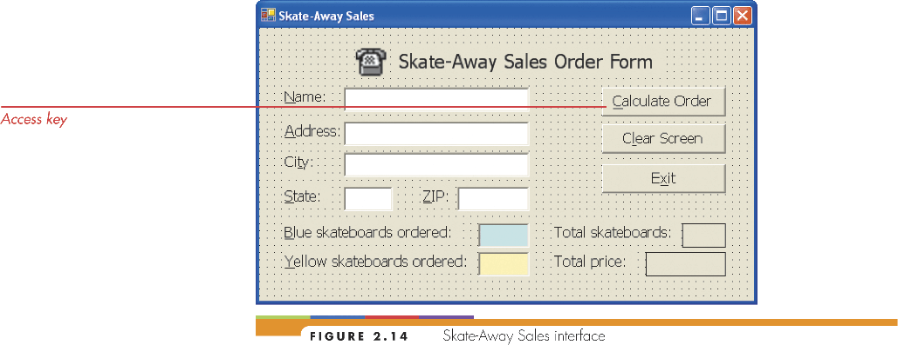
Access Keys

Slide 19
Tab Order
Each control’s TabIndex property contains a number, beginning with 0, that represents the order in which the control was added to the form.
The TabIndex values determine the tab order, which is the order in which each control receives the focus when the user either presses the Tab key.
When a control has the focus, it can accept user input.
To change the tab order from the default, you make a list of all the controls that can accept user input arranged according to the sequence the user would want to access these controls (including labels that identify controls that also accept inputs such as text boxes). All other non-input controls come at the end of the list in no particular order.
Assign Tabindex value (in the property window) to each control on the list sequentially.

Slide 20
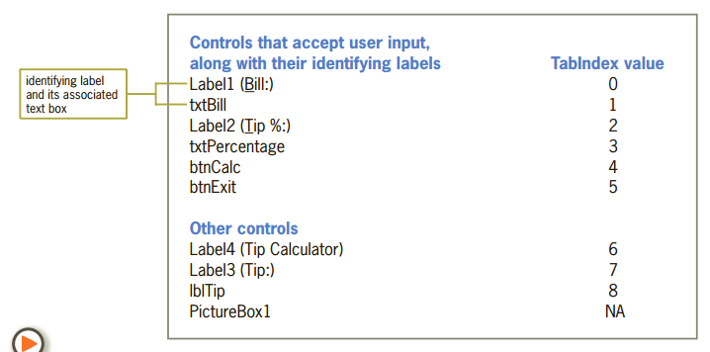
Tab Order

Slide 21
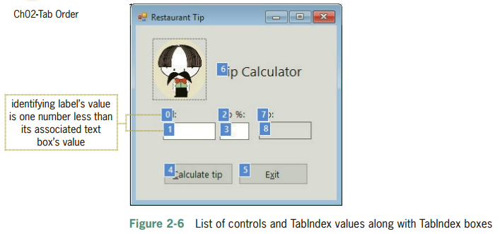
Tab Order

Slide 22
Designing Access Keys (continued)

Slide 23
Designing Default and Cancel Buttons
Default button
Selected by clicking it or pressing Enter key
Specify by setting AcceptButton property of form
Cancel button
Selected by clicking or pressing the Esc key
Specify by setting CancelButton property of form

Slide 24
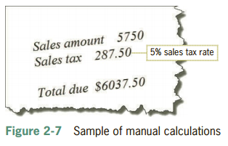
Tutorials
For every purchase made at the Bunburutu stores, the store’s cashiers manually calculate the amount of sales tax to charge the customer as well as the total amount the customer owes.
The application you will create in this tutorial will computerize both calculations.
Figure 2-7 shows a sample of the manual calculations using the store’s required sales tax rate, 5%.

Slide 25
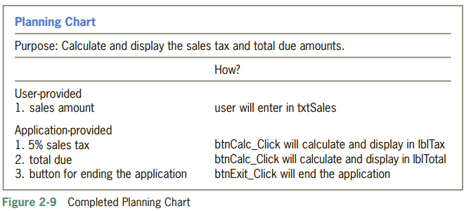
Bunburutu Planning Chart

Slide 26
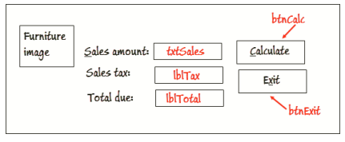
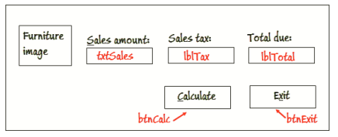
Bunburutu Control Arrangement

Slide 27
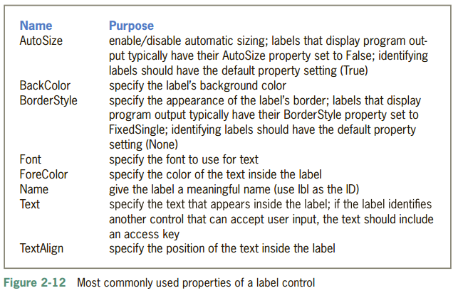
Bunburutu Stores
Add a Label Control to the Form
The purpose of a label control is to display text that the user is not allowed to edit while the application is running.

Slide 28
Bunburutu Stores
Drag a label control to the form. Position it to the left of the Total due: label and then release the mouse button. Change its Text property to Sales tax: and press Enter. This label control does not need an access key because it will identify another label control (the lblTax control), which cannot accept user input. In addition, the label control’s name can stay at its default value (Label2) because none of its events will be coded and it will not be referred to in code.
Place your mouse pointer on the Sales tax: label and reposition the control as shown in Figure 2-13. When positioning controls, you should align their text using the pink snap (or text-alignment) line. Release the mouse button.

Slide 29
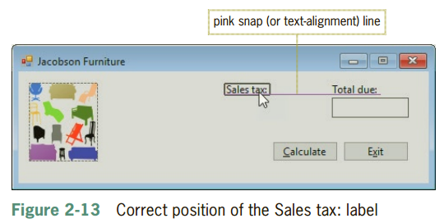
Bunburutu Stores

Slide 30
Bunburutu Stores
Drag another label control to the form. Position it to the left of the Sales tax: label and then release the mouse button. This label control will need an access key because it will identify a text box, which can accept user input. Change the label control’s Text property to &Sales amount: and press Enter. The label control’s name can stay at its default value (Label3) because none of its events will be coded and it will not be referred to in code.
Now place your mouse pointer on the label and reposition it as shown in Figure 2-14, and then release the mouse button.

Slide 31
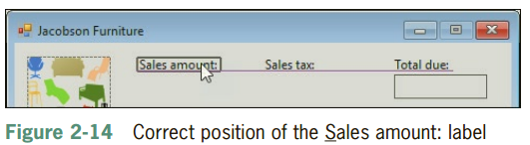
Bunburutu Stores
Drag another label control to the form. Position it below the Sales tax: label and then release the mouse button. Change its name to lblTax.
The lblTax control will display the sales tax amount calculated by the btnCalc control. As indicated earlier in Figure 2-12, label controls that display program output typically have their AutoSize and BorderStyle properties changed from the default values. Set the lblTax control’s AutoSize and BorderStyle properties to False and FixedSingle, respectively.

Slide 32
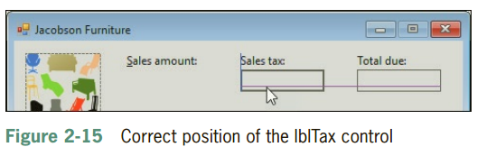
Bunburutu Stores
Click Text in the Properties list, highlight Label4 in the Settings box, press Delete, and then press Enter to remove the contents of the Text property. Click TextAlign in the Properties list, click the down arrow in the Settings box, and then click the center button to change the property to MiddleCenter.
The lblTax control should be the same size as the lblTotal control. Click the lblTotal control and then Ctrl + click the lblTax control. Use the Format menu to make the controls the same size, and then click the form to deselect the controls.
Reposition the lblTax control as shown in Figure 2-15, and then save the solution

Slide 33
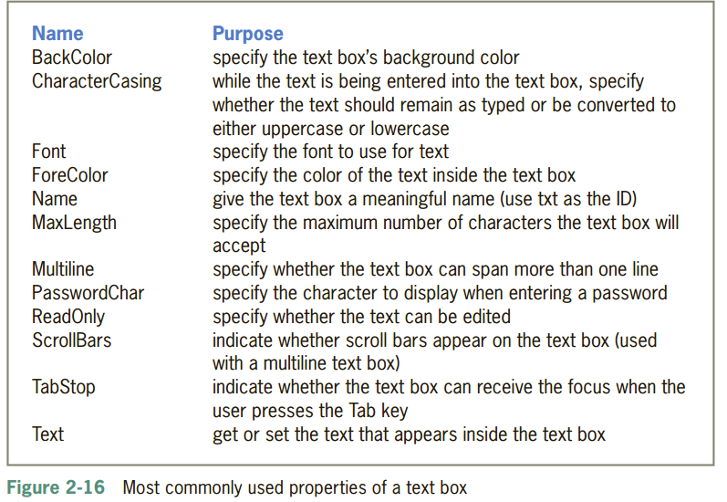
Bunburutu Stores
Add a Text Box to the Form
The purpose of a text box is to provide an area in the form where the user can enter (textual) data

Slide 34
Bunburutu Stores
Drag a text box to the form. Position it below the Sales amount: label and then release the mouse button. Change its name to txtSales.
Reposition the txtSales control as shown in Figure 2-17, and then release the mouse button.
Use the Format menu to make the text box the same size as the lblTax control, and then click the form to deselect the controls.
Lock the controls on the form and then save the solution.

Slide 35
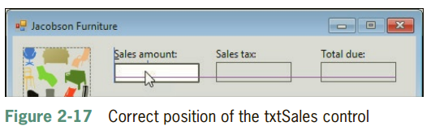
Bunburutu Stores

Slide 36
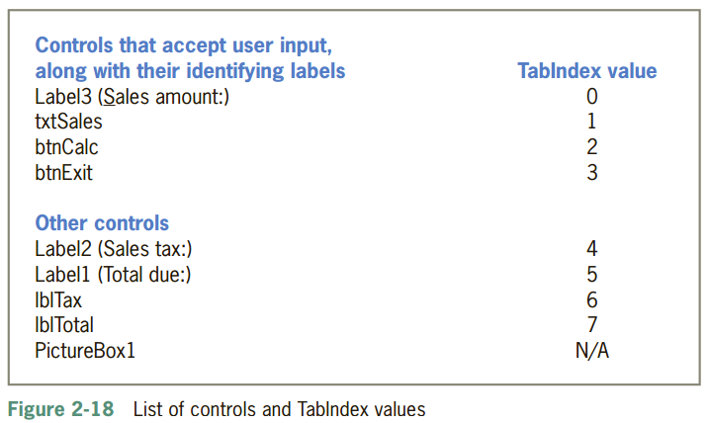
Bunburutu Stores – Tab Order

Slide 37
Bunburutu Stores – Tab Order
Click View on the menu bar and then click Tab Order. The current TabIndex values appear in blue boxes on the form. (A picture box does not have a TabIndex property.) Click the blue box on the Sales amount: label. The number in the box changes to 0 and the box’s color changes to white.
Click the blue box on the txtSales control. The number in the box changes to 1.
Set the TabIndex values for the remaining controls.
Press Esc (or click View and then click Tab Order) to remove the TabIndex boxes from the form.
Save the solution and then start the application. If the access keys do not appear in the interface, press the Alt key.
Press Tab to move the focus to the Calculate button, and then press Shift+ Tab to move the focus back to the Sales amount text box

Slide 38
Summary
To plan a Windows Forms application, perform the following five steps in the order shown:
Identify the application’s purpose.
Identify the items that the user must provide.
Identify the items that the application must provide.
Determine how the user and the application will provide their respective items.
Draw a sketch of the user interface.
Use a label control to display text that a user is not allowed to edit during run time.
Use a text box control to provide an area in the form in which a user can enter data.
Use Access keys and Tab index for keyboard shortcuts

